Slide 1
Introduction to Concurrent Programming with GPUs
Overview of Integrated versus Dedicated GPUs
Notes:
Hello and welcome to the first lecture video for the 4th module of this course.
We will focus on defining the capabilities and differences between integrated and dedicated GPUs.

Slide 2
Overview of NVidia versus integrated GPUs
Integrated GPUs
Nvidia GPUs
Use Cases and Framework Comparison
Notes:
The three topics for this video will be concerning learning about both integrated and Nvidia GPUs (a subset of dedicated GPUs) and some use cases and framework comparison

Slide 3
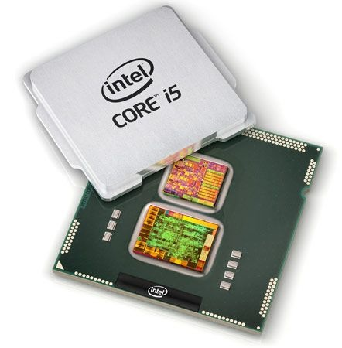
Integrated GPUs
These types of GPUs allow for general purpose programing.
They are built into the CPU and share system memory.
They tend to use less power and generate less heat.
Common in consumer laptops, because can help with battery life.
[1]
[2]
Notes:
Most base version of consumer laptops and desktops are configured with this type of hardware.
They don’t support vendor-specific programming frameworks such as CUDA, but can be used with general or heterogenous programming frameworks including OpenCL and OpenACC.
Often the same company that makes a CPU for a machine will make the integrated GPU that it uses, since the GPU is on the same chip.
That is what integrated means in this case, integrated with the CPU.
Positives are that they are physically close to GPU and share system memory. They also get less hot and use less power, so help with battery life.
Downsides are that they are much less powerful, lagging well behind dedicate GPUs since they must be coresident with the CPU.

Slide 4
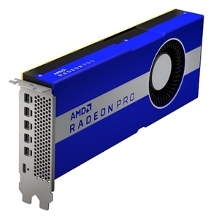
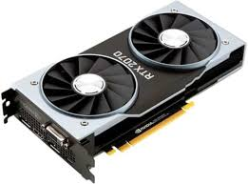
Nvidia GPUs
These devices are specific vendor’s (Nvidia) implementation of dedicated GPUs.
Other vendors produce dedicated GPUs, including AMD.
They are separate from the CPU and do not share memory.
They use more power and generated more heat.
They are more commonly used in desktops.
Nvidia has a separated programming framework to take more specific control of GPU hardware.
[1]
[3]
[4]
Notes:
Nvidia makes the most commonly available programmable GPUs, by that I mean that AMD makes their own GPUs that are very powerful, but they don’t have the same level of adoption of programming directly on the GPU, they are more oriented to video and gaming applications.
Nvidia GPUs are getting better at getting more processing with less power consumption and therefor less heat.
Powerful laptops can be built with Nvidia cards included but they are more commonly found in desktops and servers.
Unfortunately you cannot get a mac with Nvidia GPU, only AMD, which is probably related to their lack of interest in OpenCL and CUDA, focusing more on their own GPU programming framework Metal.

Slide 5
Use Cases and Framework Comparison
Integrated GPUs can be very useful in general situations, where the target hardware may vary.
Dedicated GPUs are used for more powerful workflows, such natural language processing, computer vision, and other machine learning techniques.
OpenCL is one of the most common open source heterogenous computing platforms with support for most CPU and GPU hardware.
OpenACC is newer framework for making it easier to use numerous types of accelerators, including CPUs and GPUs. It aims to use pragma to make accelerating software require less code.
CUDA is the leading framework for developing code that executes on Nvidia GPUs. It controls both high and low-level access to processing and memory capabilities.
[5]
Notes:
A common use case for integrated GPUs is under less defined programming or heterogeneous workflows, since a GPU might or might not be used and therefor the cost of the hardware and extra power consumption is lower.
Dedicated GPU have become more heavily used under use cases such as cryptocurrency mining/verification, NLP (natural language programming), and computer vision.
In the case of NLP and computer vision, programmers are often either directly or indirectly using neural networks, since they map really well to the Nvidia hardware, performing when there are many processors doing a small amount of work.
If a program needs to take advantage of different types of hardware for different tasks, OpenCL is a widely used open source computing framework that is built around supporting as many hardware platforms as possible.
OpenCL code is in separate files or compiled into C/C++ code as text that is then sent to the hardware (compiling in place).
The follow-on to OpenCL is OpenACC, which removes the requirement to have separate code, but rather has developers use macros around sections of code that can utilize accelerators such as GPUs and Field-Programmable Gate Arrays.
CUDA is the most widely adopted framework and give more access to the developer throughout the Nvidia hardware.

Slide 6
Bibliography
[1] intel.com 2020. intel.com What Is the Difference Between Integrated Graphics and Discrete Graphics?. Retrieved from https://www.intel.com/content/www/us/en/support/articles/000057824/graphics.html
[2] engadget.com 2010. engadget.com Intel's Arrandale and Clarkdale CPUs get benchmarked for your enjoyment. Retrieved from https://www.engadget.com/2010-01-04-intels-arrandale-and-clarkdale-cpus-get-benchmarked-for-your-en.html?guccounter=1&guce_referrer=aHR0cHM6Ly93d3cuZ29vZ2xlLmNvbS8&guce_referrer_sig=AQAAANIL86YxOyUbBuVvGM-PEGHJnR5aAtsxInqs1FTz9CpuHcTcP2msNLQ8azJ7cnBcaWczT87yuBdJDS3bshgdE-THv1Fh6fmVpwOhb3AgYyhPqjKbTwb8XznikqX0At94FHPobfK_p7mhJSPCuFtGZd8O4Cr5QiQnOJQIhVYBj6Is

Slide 7
Bibliography continued
[3] dell.com 2020. dell.com Dell AMD Radeon Pro W5700 workstation graphics card. Retrieved from https://www.dell.com/en-us/work/shop/dell-amd-radeon-pro-w5700-workstation-graphics-card/apd/490-bfsr/graphic-video-cards?gacd=9646510-1025-5761040-266794296-0&dgc=st&ds_rl=1282786&gclid=CjwKCAiAgJWABhArEiwAmNVTBwaXLTBQ0EjG2U-jNwy4eNsEy2iGjrHZIHbX6LRoDDQKPctNPKg9cBoCB1sQAvD_BwE&gclsrc=aw.ds
[4] gpumag.com 2010. gpumag.com Dedicated vs. Integrated Graphics Cards – Which Is Best For You?. Retrieved from https://www.gpumag.com/dedicated-vs-integrated-graphics-cards/
[5] openacc.org 2020. openacc.org OpenACC Programming and Best Practices Guide. Retrieved from https://www.openacc.org/sites/default/files/inline-files/OpenACC_Programming_Guide_0.pdf

